Slide 1
Chapter-6
Additional Data Types and Plot Types

Slide 2


Outline
Complex Data
String Functions
Multidimensional Arrays
Additional Data Types
Additional Two-Dimensional Plots
Three-Dimensional Plots

Slide 3
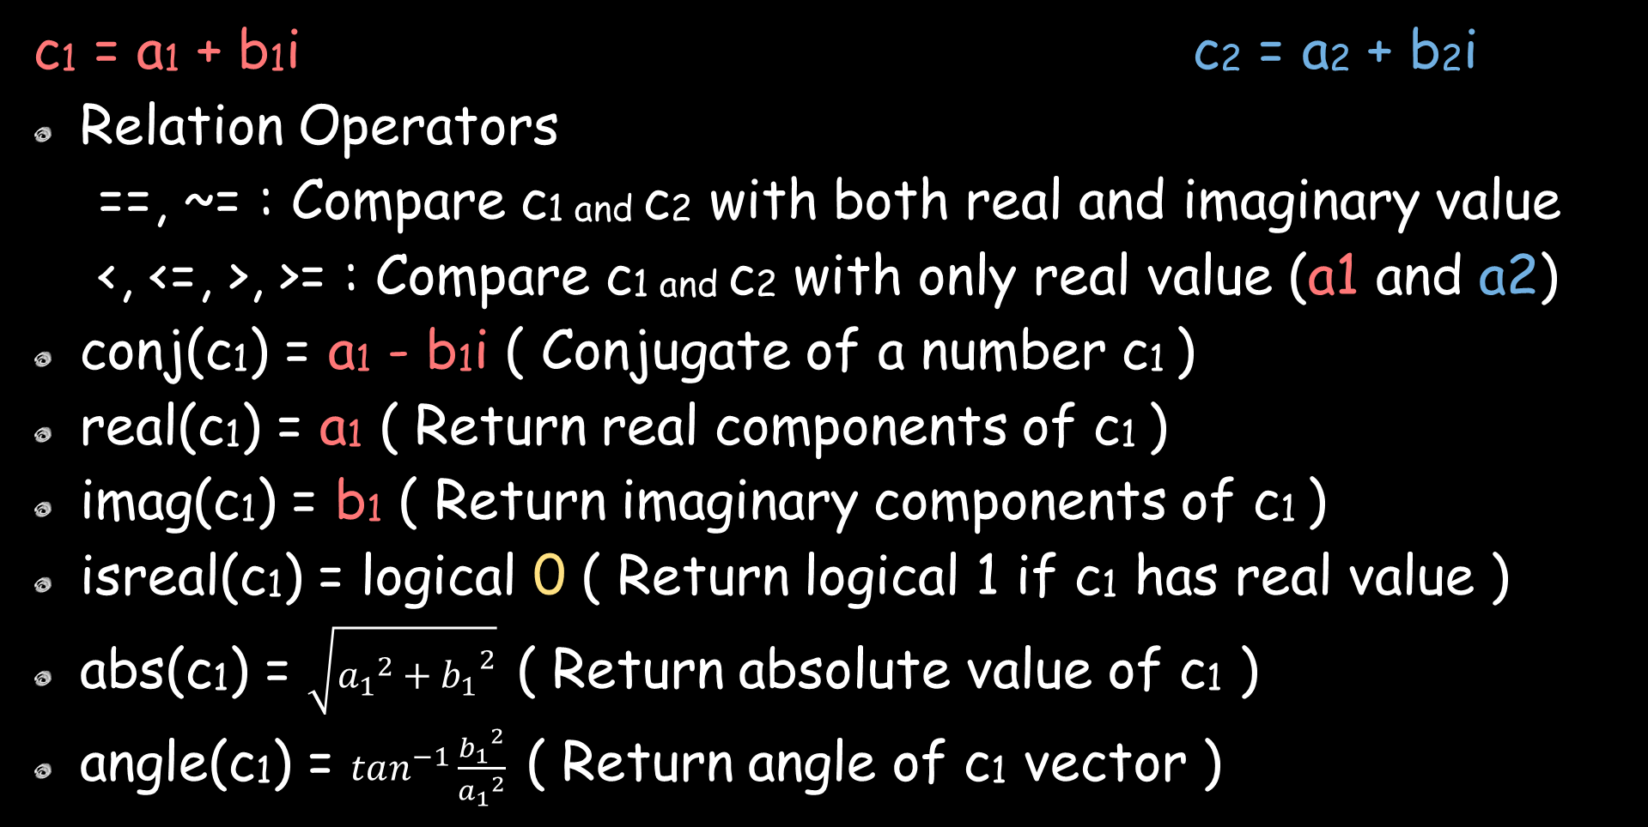



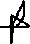
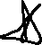
Complex Data
c1 = a1 + b1i c2 = a2 + b2i
Relation Operators
==, ~= : Compare c1 and c2 with both real and imaginary value
<, <=, >, >= : Compare c1 and c2 with only real value (a1 and a2)
conj(c1) = a1 - b1i ( Conjugate of a number c1 )
real(c1) = a1 ( Return real components of c1 )
imag(c1) = b1 ( Return imaginary components of c1 )
isreal(c1) = logical 0 ( Return logical 1 if c1 has real value )
abs(c1) = $\sqrt{{a_{1}}^{2}+{b_{1}}^{2}}$ ( Return absolute value of c1 )
angle(c1) = $tan^{−1}\frac{{b_{1}}^{2}}{{a_{1}}^{2}}$ ( Return angle of c1 vector )

Slide 4
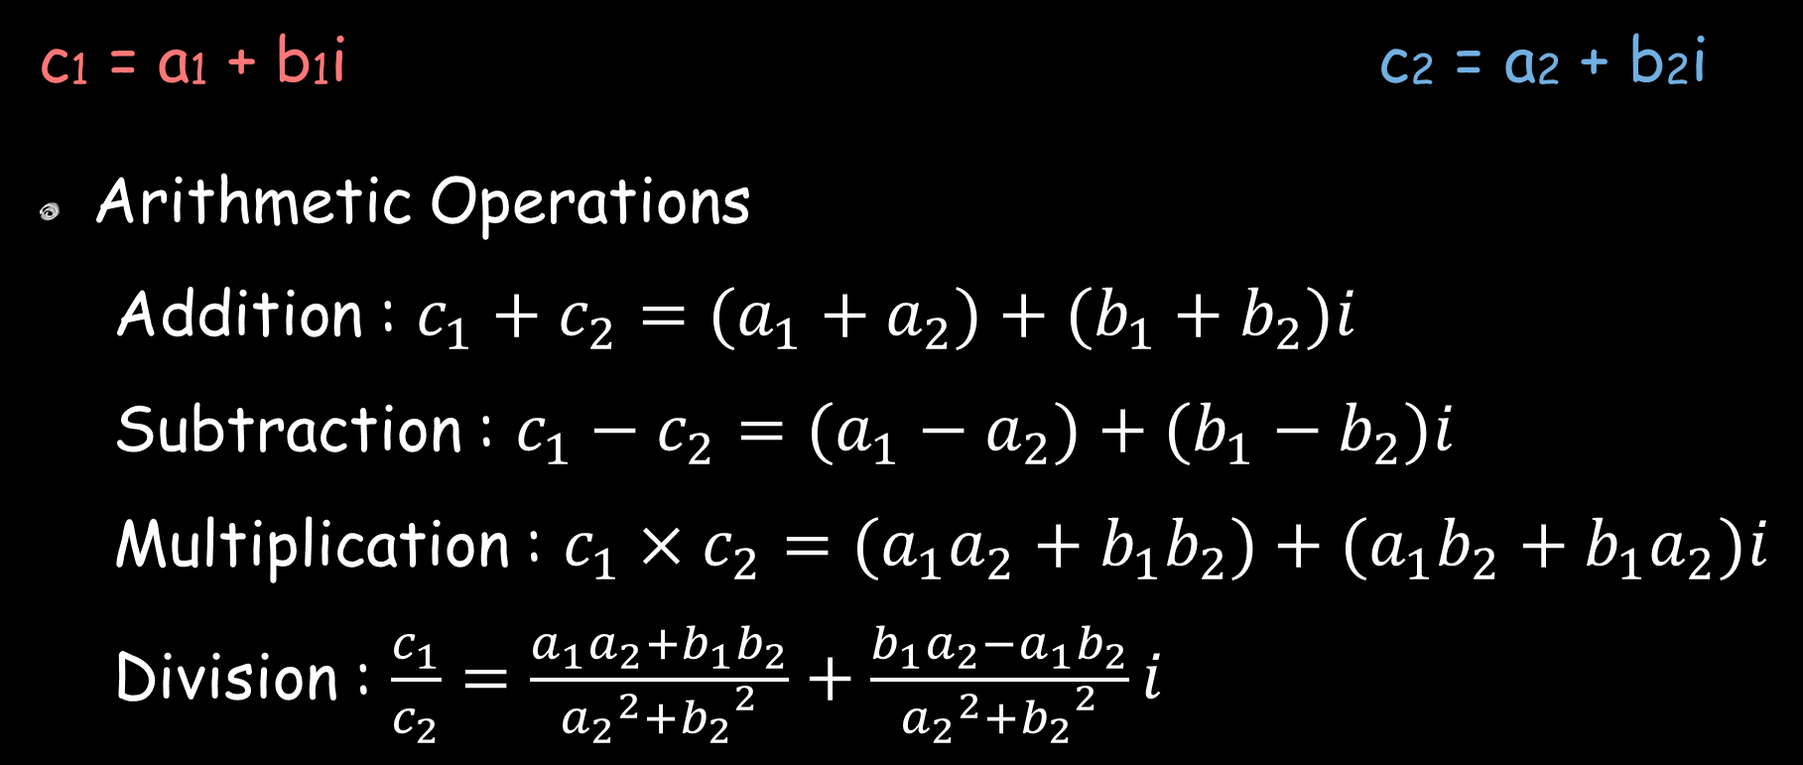


Complex Data
c1 = a1 + b1i c2 = a2 + b2i
Arithmetic Operations
Addition : $c_{1}+c_{2}=(a_{1}+a_{2})+(b_{1}+b_{2})i$
Subtraction : $c_{1}−c_{2}=(a_{1}−a_{2})+(b_{1}−b_{2})i$
Multiplication : $c_{1}×c_{2}=(a_{1}a_{2}+b_{1}b_{2})+(a_{1}b_{2}+b_{1}a_{2})i$
Division : $\frac{c_{1}}{c_{2}}=\frac{a_{1}a_{2}+b_{1}b_{2}}{{a_{2}}^{2}+{b_{2}}^{2}}+\frac{b_{1}a_{2}−a_{1}b_{2}}{{a_{2}}^{2}+{b_{2}}^{2}}i$

Slide 5
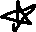

Command Window
>> c1 = 3 + 4i
c1 =
3 + 4i
>> conj(c1)
ans =
3 - 4i
>> real(c1)
ans =
3
>> imag(c1)
ans =
4
>> isreal(c1)
ans =
logical
0
>> abs(c1)
ans =
5
>> angle(c1)
ans =
0.9273
>> c2 = 1 + 2i
c2 =
1 + 2i
>> addition = c1 + c2
addition =
4 + 6i
>> subtraction = c1 - c2
subtraction =
2 + 2i

Slide 6

Command Window
>> multiplication = c1 * c2
multiplication =
-5 + 10i
>> division = c1 / c2
division =
2.2 - 0.4i

Slide 7






String Function
String is an array of type char and each character is stored in two bytes of memory.
ischar(variable) - returns 1 if variable type is char
Command Window
>> str = 'Poojan 18BCE166';
>> whos
Name Size Bytes Class Attributes
str 1x14 28 char
>> ischar(str)
ans =
logical
1

Slide 8
String Function
String Conversion Function | double(str) | Convert to double datatype
 | char(vector) | Convert to character datatype
Creating 2-D Character Array | char(rowStr1, rowStr2, rowStr3, …)
 | strvcat(rowStr1, rowStr2, rowStr3, …)
Concatenating Strings | strcat(str1, str2) | Concatenate strings horizontally
 | strvcat(str1, str2) | Concatenate strings vertically
Comparing Two Strings | strcmp(str1,str2) | Comparing two strings
 | strcmpi(str1,str2) | Comparing two strings (ignoring case)
 | strncmp(str1,str2,n) | Comparing first n letters two strings
 | strncmpi(str1,str2,n) | Comparing first n letters two strings (ignoring case)

Slide 9

String Function
Categorizing Character (Check character by character) | isletter(str) | Check character is letter
 | isspace(str) | Check character is whitespace
 | isstrprop(str,‘category’) | General function to check category
Category | Description
‘alpha’ | Return true(1) for each alphabetic character
‘alphanum’ | Return true(1) for each alphabetic and number character
‘cntrl’ | Return true(1) for each control character
‘digit’ | Return true(1) for each digit character
‘lower’ | Return true(1) for each lower case character
‘wspace’ | Return true(1) for each wspace character
‘upper’ | Return true(1) for each upper case character
‘xdigit’ | Return true(1) for each hexadecimal digit character

Slide 10

String Function
Searching and Replacing Character | findstr(str,word) | Find word position in str (str has only one row)
 | strmatch(word,str) | Find word position in str (Only check beginning character)
 | strrep(str,replaceWord,newWord) | Replace the replaceWord with newWord in str
 | strtok(str) | Gives first word of the str
Uppercase and Lowercase | upper(str) | converts all str characters into upper case
 | lower(str) | converts all str characters into lower case
Trimming Whitespace | deblank(str) | Removes trailing whitespace
 | strtrim(str) | Remove both, leading and trailing whitespace

Slide 11
String Function
Number to String | int2str(integer) | Convert integer to string
 | num2str(number) | Convert number to string
 | mat2str(matrix) | Convert matrix to string
 | sprintf(“%5.2f”,num) | Write formatted data in string
String to Number | eval(str) | Evaluate str as an expression
 | str2double(str) | Convert string to double
 | str2num(str) | Convert string to number
 | sscanf(var,format) | Read formatted data from string

Slide 12
String Function
Base Number Conversion | hex2num(str) | Convert hexadecimal to number
 | hex2dec(str) | Convert hexadecimal to decimal
 | dec2hex(number) | Convert decimal to hexadecimal
 | bin2dec(binaryStr) | Convert decimal to hexadecimal
 | dec2bin(number) | Convert decimal to binary
 | dec2base(number, B, N) | Convert decimal to base B string
 | base2dec(str, B) | Convert base B string to decimal

Slide 13



Command Window
>> % String Conversion Function
>> %
>> str = ‘Shubh';
>> strDouble = double(str)
strDouble =
83 104 117 98 104
>> strChar = char(strDouble)
strChar =
‘Shubh'
>> %
>> % Creating 2-D Character Array
>> %
>> str2dChar = char('Poojan','18BCE166')
str2dChar =
2×8 char array
'Poojan '
'18BCE166'
>> str2dStrvcat = strvcat('Poojan','18BCE166')
str2dStrvcat =
2×8 char array
'Poojan '
'18BCE166'
>> %
>> % Concatenating String
>> %
>> strCat = strcat('Poojan','18BCE166')
strCat =
'Poojan18BCE166'
>> str2dStrvcat = strvcat('Poojan','18BCE166')
str2dStrvcat =
2×8 char array
'Poojan '
'18BCE166'

Slide 14
Command Window
>> %
>> % Comparing Two Strings
>> %
>> strCmp = strcmp('Poojan','poojan')
strCmp =
logical
0
>> strCmpi = strcmpi('Poojan','poojan')
strCmpi =
logical
1
>> strnCmp = strncmp('Poojan','poojan',3)
strnCmp =
logical
0
>> strnCmpi = strncmpi('Poojan','poojan',3)
strnCmpi =
logical
1
>> %
>> % Categorizing Character
>> %
>> str = 'PoojanPatel 18BCE166\t ';
>> isLetter = isletter(str)
isLetter =
1×24 logical array
1 1 1 1 1 1 1 1 1 1 1 0 0 0 1 1 1 0 0 0 0 1 0 0
>> isSpace = isspace(str)
isSpace =
1×24 logical array
0 0 0 0 0 0 0 0 0 0 0 1 0 0 0 0 0 0 0 0 0 0 1 1

Slide 15
Command Window
>> isstrprop(str,'alpha')
ans =
1×24 logical array
1 1 1 1 1 1 1 1 1 1 1 0 0 0 1 1 1 0 0 0 0 1 0 0
>> isstrprop(str,'alphanum')
ans =
1×24 logical array
1 1 1 1 1 1 1 1 1 1 1 0 1 1 1 1 1 1 1 1 0 1 0 0
>> isstrprop(str,'cntrl')
ans =
1×24 logical array
0 0 0 0 0 0 0 0 0 0 0 0 0 0 0 0 0 0 0 0 0 0 0 0
>> isstrprop(str,'digit')
ans =
1×24 logical array
0 0 0 0 0 0 0 0 0 0 0 0 1 1 0 0 0 1 1 1 0 0 0 0
>> isstrprop(str,'lower')
ans =
1×24 logical array
0 1 1 1 1 1 0 1 1 1 1 0 0 0 0 0 0 0 0 0 0 1 0 0
>> isstrprop(str,'wspace')
ans =
1×24 logical array
0 0 0 0 0 0 0 0 0 0 0 1 0 0 0 0 0 0 0 0 0 0 1 1
>> isstrprop(str,'upper')
ans =
1×24 logical array
1 0 0 0 0 0 1 0 0 0 0 0 0 0 1 1 1 0 0 0 0 0 0 0

Slide 16


Command Window
>> %
>> % Searching and Replacing Character
>> %
>> str = 'Poojan Patel 18BCE166, Shubh Patel 18BCE171';
>> findStr = findstr(str,'Patel')
findStr =
8 29
>> str = char('18BCE166 Poojan Patel','18BCE171 Shubh Patel');
>> strMatch = strmatch('18BCE',str)%startswith(_),strncmp(),validatestring()%add “”exact”
strMatch =
1
2
>> str = 'Poojan Patel 18BCE166 Shubh Patel 18BCE171';
>> strRep = strrep(str,'18BCE','19BCE')
strRep =
'Poojan Patel 19BCE166 Shubh Patel 19BCE171'
>> strTok = strtok(str)
strTok =
'Poojan'
>> %
>> % Uppercase and Lowercase
>> %
>> str = 'Poojan Patel';
>> Upper = upper(str)
Upper =
‘POOJAN PATEL'
>> Lower = lower(str)
Lower =
'poojan patel'
>> %
>> % Trimming Whitespace
>> %

Slide 17
Command Window
>> str = ' Poojan Patel ';
>> Deblank = deblank(str)
Deblank =
' Poojan Patel'
>> strTrim = strtrim(str)
strTrim =
'Poojan Patel'
>> %
>> % Number to String
>> %
>> int2Str = int2str(10)
int2Str =
'10'
>> num2Str = num2str(3.1416)
num2Str =
'3.1416'
>> mat2Str = mat2str([1, 2, 3, 4])
mat2Str =
'[1 2 3 4]'
>> mat2Str = mat2str([1, 2; 3, 4])
mat2Str =
'[1 2;3 4]'
>> sprintf("Value of pi = %5.2f",3.1416)
ans =
"Value of pi = 3.14"
>> %
>> % String to Number
>> %
>> Eval = eval('2 * 3.1416')
Eval =
6.2832

Slide 18





Command Window
>> str2Double = str2double('3.1416')
str2Double =
3.1416
>> str2Num = str2num('3.0000')
str2Num =
3
>> Sscanf = sscanf('3.1416','%d')
Sscanf =
3
>> %
>> % Base Number Conversion
>> %
>> hex2Num = hex2num('406fe00000000000')
hex2Num =
255
>> hex2Dec = hex2dec('ff')
hex2Dec =
255
>> dec2Hex = dec2hex(255)
dec2Hex =
'FF'
>> bin2Dec = bin2dec('1011')
bin2Dec =
11
>> dec2Bin = dec2bin(11)
dec2Bin =
'1011'
>> dec2Base = dec2base(11,3,5)
dec2Base =
'00102'
>> base2Dec = base2dec('102',3)
base2Dec =
11

Slide 19


Multidimensional Array
Syntax :
array(row, column, subscript)
Command Window
>> a = [1 2 3; 4 5 6]
a =
1 2 3
4 5 6
>> a(:,:,2) = [10 20 30; 40 50 60];
>> a(:,:,3) = [100 200 300; 400 500 600]
a(:,:,1) =
1 2 3
4 5 6
a(:,:,2) =
10 20 30
40 50 60
a(:,:,3) =
100 200 300
400 500 600

Slide 20
Command Window
>> a(2,2,2)
ans =
50
>> a(2,2,:)
ans(:,:,1) =
5
ans(:,:,2) =
50
ans(:,:,3) =
500
>> Ones = ones(1,2,2)
Ones(:,:,1) =
1 1
Ones(:,:,2) =
1 1
>> Randn = randn(2,2,3)
Randn(:,:,1) =
-1.1486 -0.51042
1.1076 -2.1122
Randn(:,:,2) =
1.5041 -1.0732
0.49128 -0.33426
Randn(:,:,3) =
-1.3942 0.84818
-1.0036 -1.0592
>> ndims(Randn)
ans =
3
>> size(Randn)
ans =
2 2 3

Slide 21



Additional Data Types
single(number) | Create number with class type single
int8(number) | Create number with class type int8
int16(number) | Create number with class type int16
You can perform arithmetic operation with same class type or double class type

Slide 22
Command Window
>> Single = single(3.1)
Single =
single
3.1
>> a = 4;
>> b = Single * a
b =
single
12.4
>> whos
Name Size Bytes Class Attributes
Single 1x1 4 single
a 1x1 8 double
b 1x1 4 single
>> Int8 = int8(4)
Int8 =
int8
4
>> c = 7;
>> d = Int8 * c
d =
int8
28
>> whos
Name Size Bytes Class Attributes
Int8 1x1 1 int8
Single 1x1 4 single
a 1x1 8 double
b 1x1 4 single
c 1x1 8 double
d 1x1 1 int8

Slide 23



Additional Two-Dimensional Plots
bar(x,y) | Create vertical bar plot, with x values in label and y values used for height
barh(x,y) | Create horizontal bar plot, with x values in label and y values used for height
compass(x,y) | Creates a polar plot, with an arrow drawn from the origin to each (x, y) point location
pie(x) pie(x, explode) | Creates a pie plot that determines the percentage of the total pie corresponding to each value of x. Explode array is indicate that determine which pie slices are separated from the pie plot
stairs(x,y) | Creates a stair plot, with each stair step centred on an (x, y) point
stem(x,y) | Creates a stem plot in which there are marker at each point (x, y) and drawn vertical line to x-axis

Slide 24
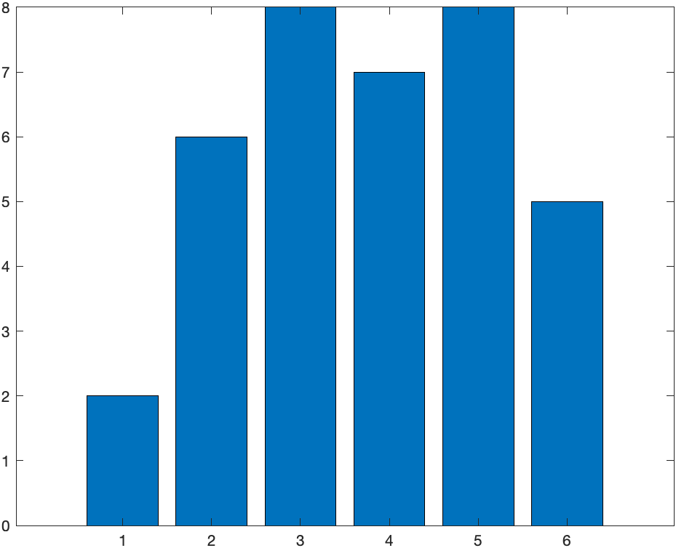
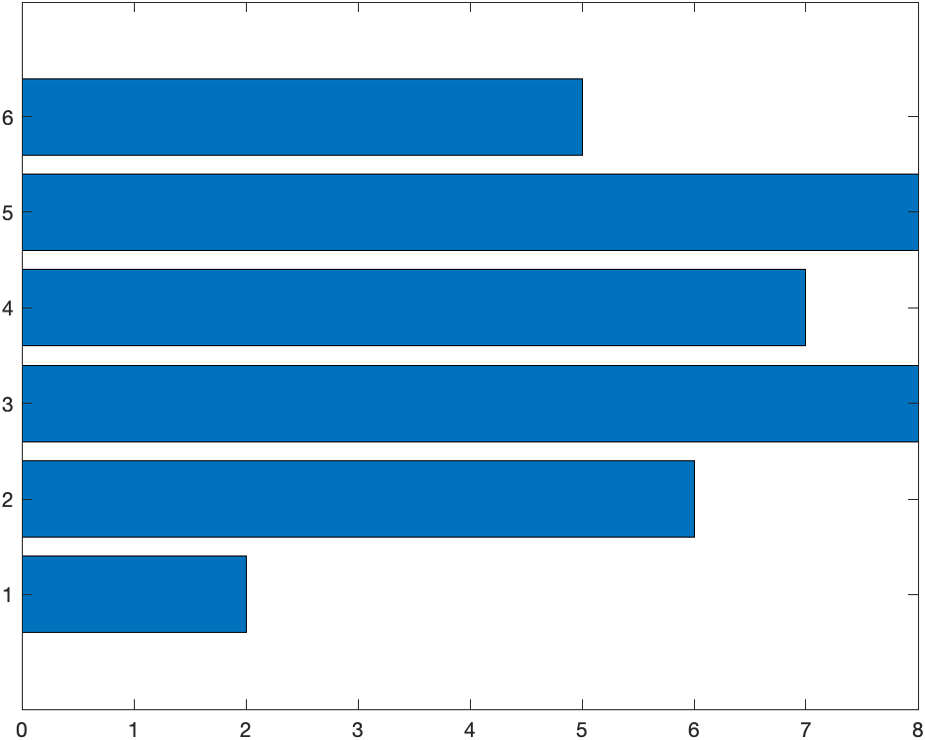
Command Window
>> x = [1 2 3 4 5 6];
>> y = [2 6 8 7 8 5];
>> bar(x,y)
>> barh(x,y)

Slide 25
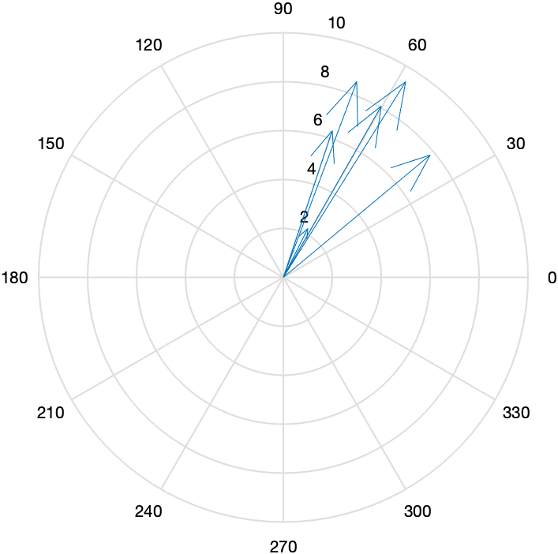
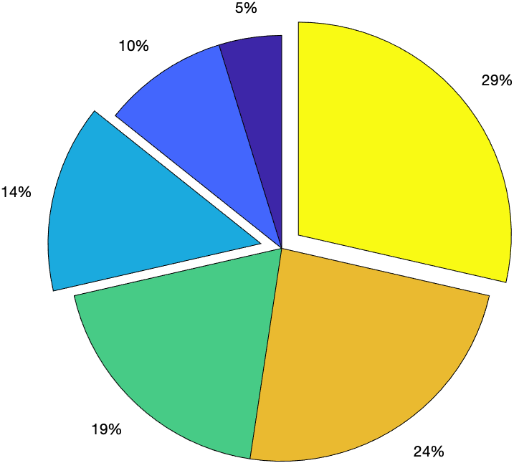
Command Window
>> compass(x,y)
>> pie(x,[0 0 1 0 0 1])

Slide 26
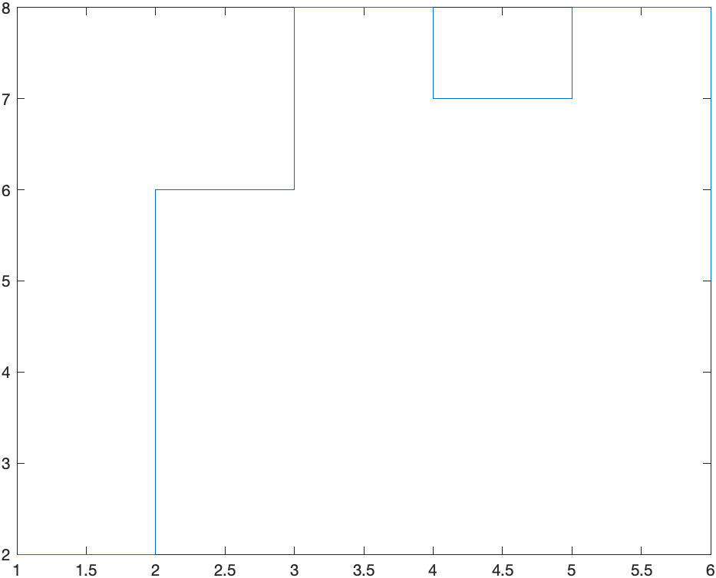
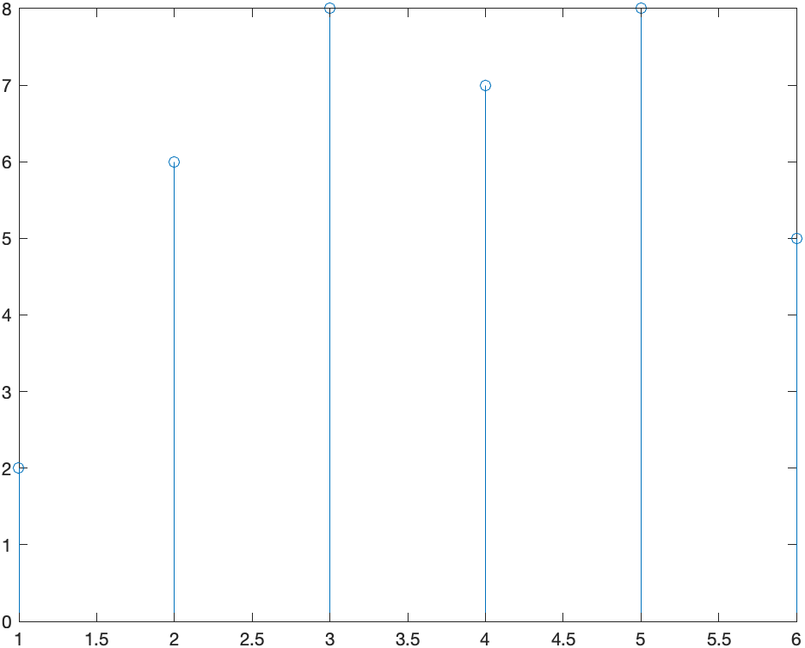
Command Window
>> stairs(x,y)
>> stem(x,y)

Slide 27

Additional Two-Dimensional Plots
ezplot(fun,range,figure) | Create a plot for the given fun in string for the given range
fplot(fun,range) | Create a plot for the given fun for the given range
[n, xout] = hist(y, nbins/x) | If we use hist(y) then it separated 10 equally spaced bins. If we use hist(y, nbins) then it separated nbins equally spaced bins. If we use hist(y, x) then it separated with the centres specified bins in x vector. It will return count of each bins as n and each bins centre as xout.

Slide 28
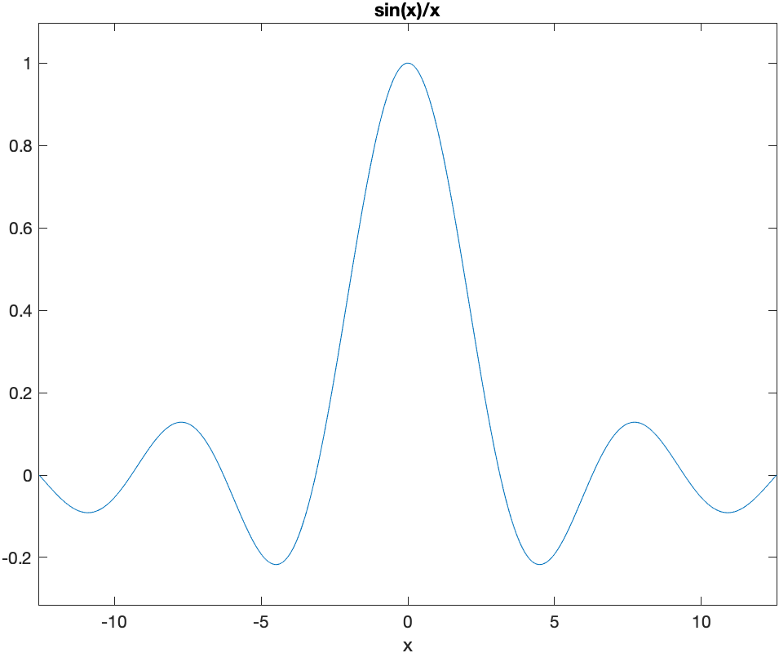
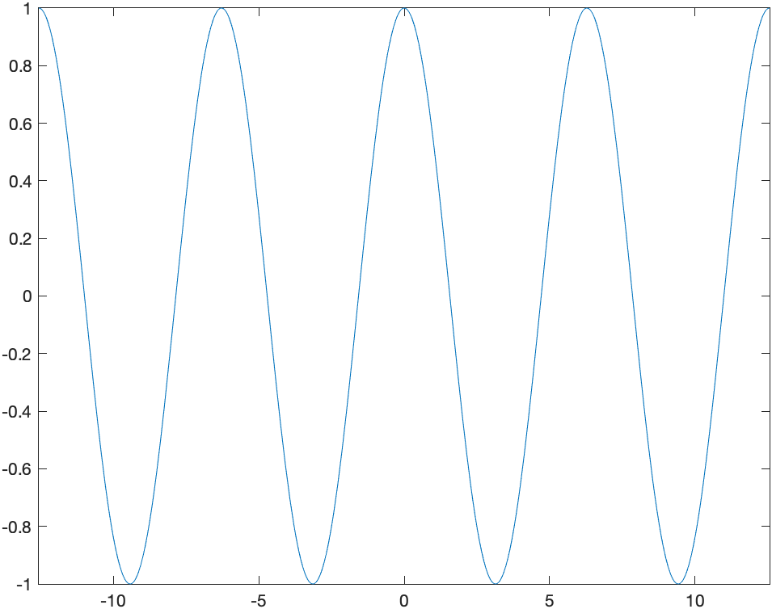
Command Window
>> ezplot('sin(x)/x',[-4*pi 4*pi])
>> fplot(@cos,[-4*pi 4*pi])

Slide 29
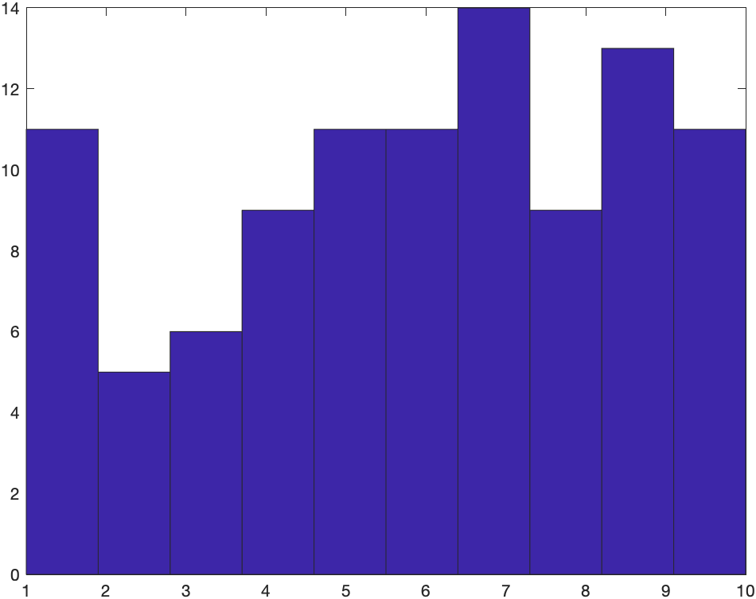
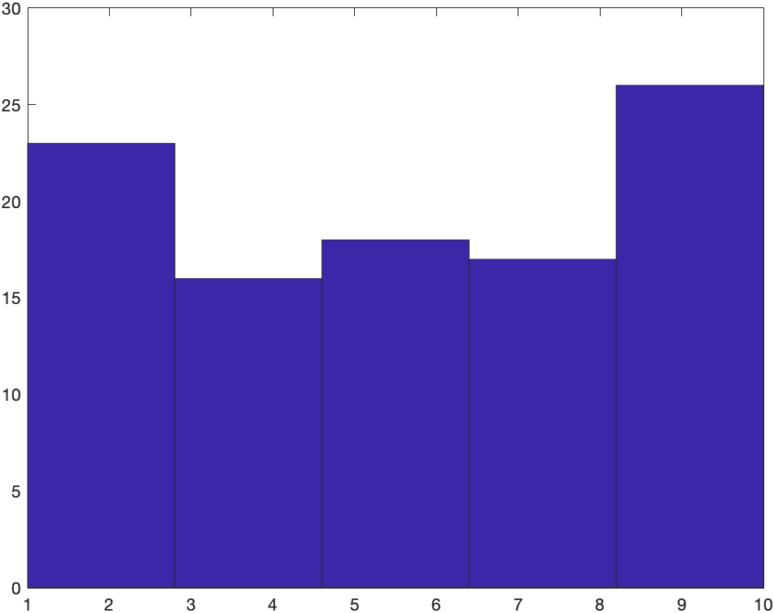
Command Window
>> hist(randi(10,1,100))
>> hist(randi(10,1,100),5)

Slide 30
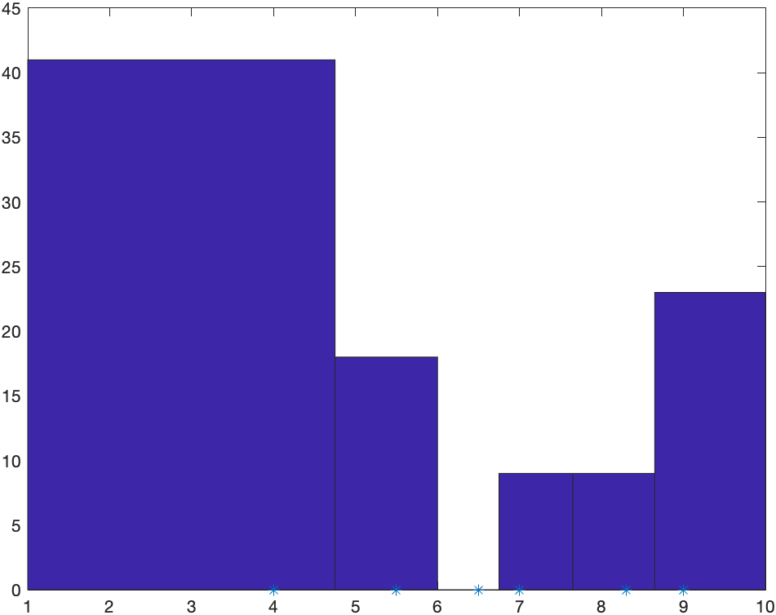
Command Window
>> hist(randi(10,1,100),[4 5.5 6.5 7 8.3 9])
>> [n, xout] = hist(randi(10,1,100))
n =
11 11 10 10 10 8 12 12 6 10
xout =
Columns 1 through 7
1.45 2.35 3.25 4.15 5.05 5.95 6.85
Columns 8 through 10
7.75 8.65 9.55
>> [n, xout] = hist(randi(10,1,100),5)
n =
16 21 27 21 15
xout =
1.9 3.7 5.5 7.3 9.1
>> [n, xout] = hist(randi(10,1,100),[4 5.5 6.5 7 8.3 9])
n =
30 20 0 16 15 19
xout =
4 5.5 6.5 7 8.3 9

Slide 31





Three-Dimensional Plots
plot3(x,y,z) | Create 3-D plot
mesh(x,y,z) | Creates a mesh or wireframe plot and x, y and z all are two dimension array containing every point to display
surf(x,y,z) | Creates a surface plot and array x, y and z same as mash plot
contour(x,y,z) contour3(x,y,z) | Creates a contour plot and array x, y and z same as mash plot Contour3 is representation of contour graph in another angle

Slide 32
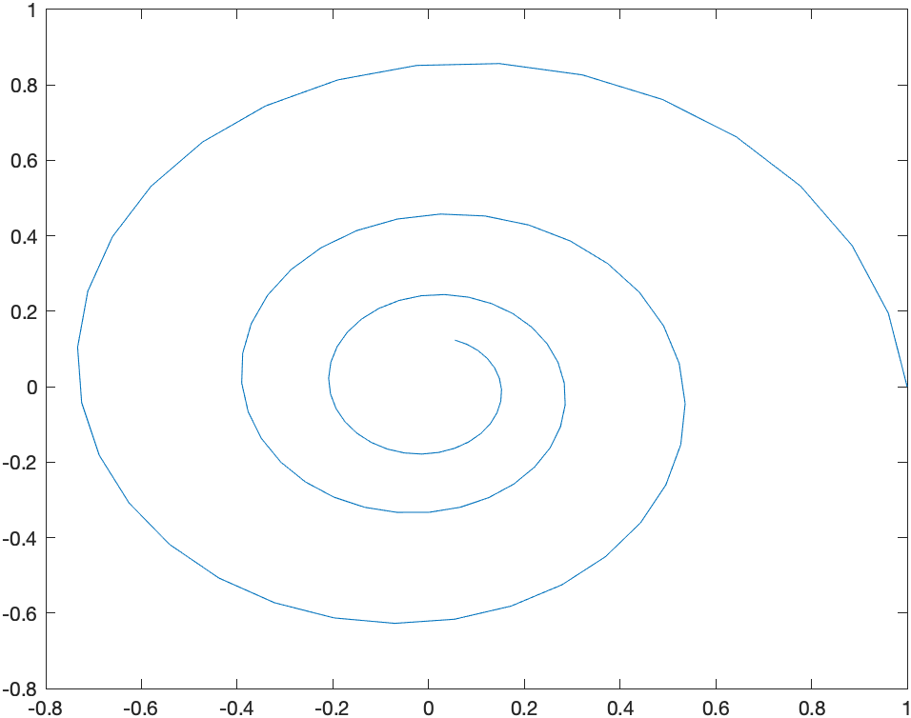
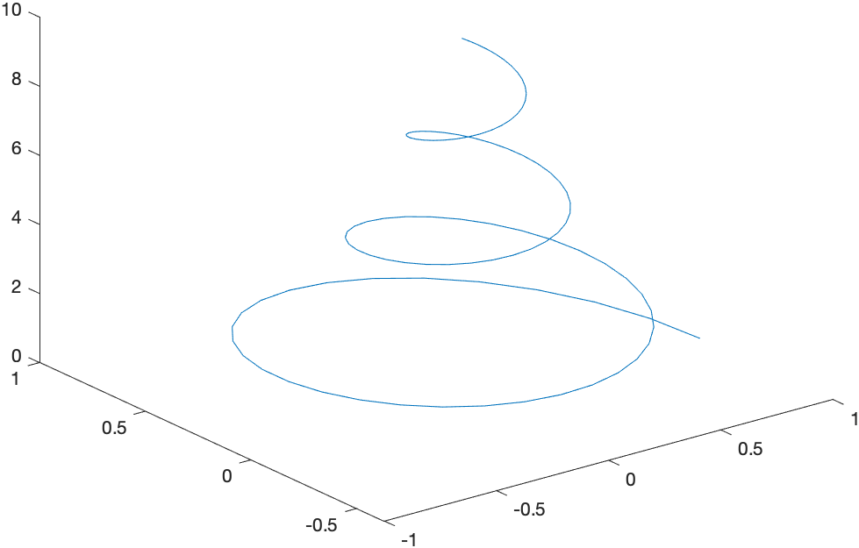
Command Window
>> t = 0:0.1:10;
>> x = exp(-0.2*t) .* cos(2*t);
>> y = exp(-0.2*t) .* sin(2*t);
>> plot(x,y)
>> plot3(x,y,t)

Slide 33
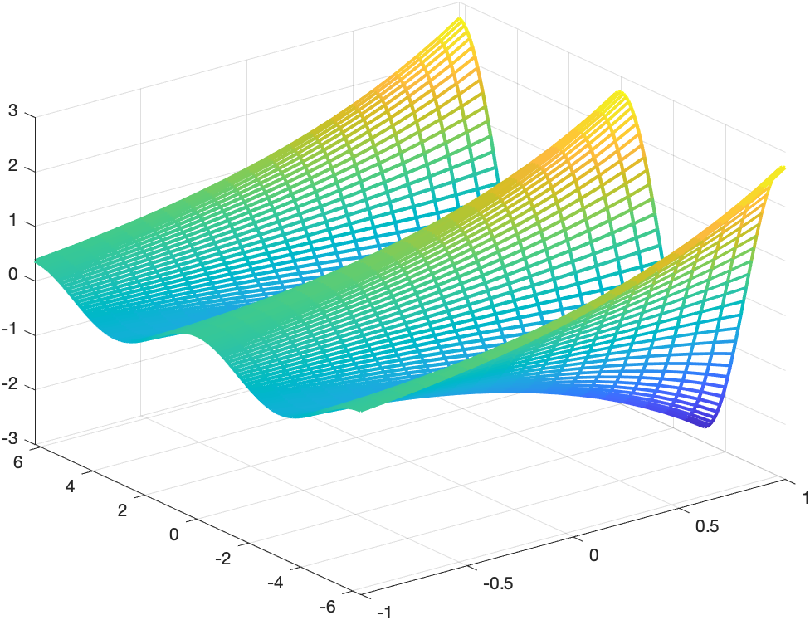
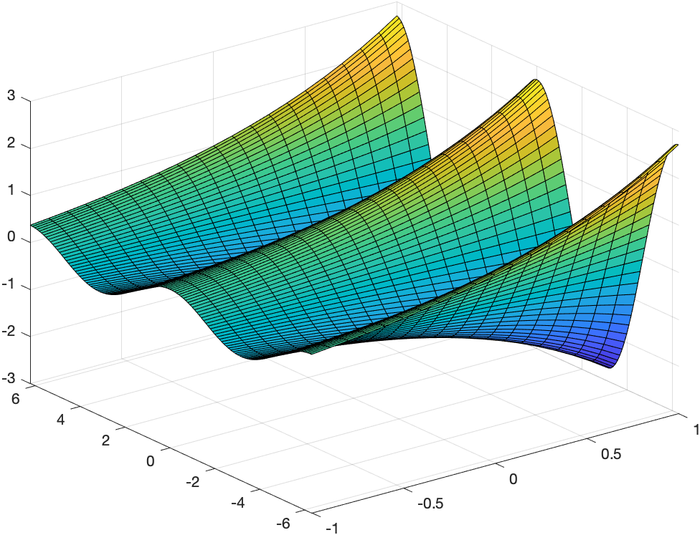
Command Window
>> x = -1:0.1:1;
>> y = -2*pi:0.1:2*pi;
>> [x, y] = meshgrid(x, y);
>> z = exp(x + 1i * y);
>> mesh(x,y,real(z),’Linewidth',2);
>> surf(x,y,real(z));

Slide 34
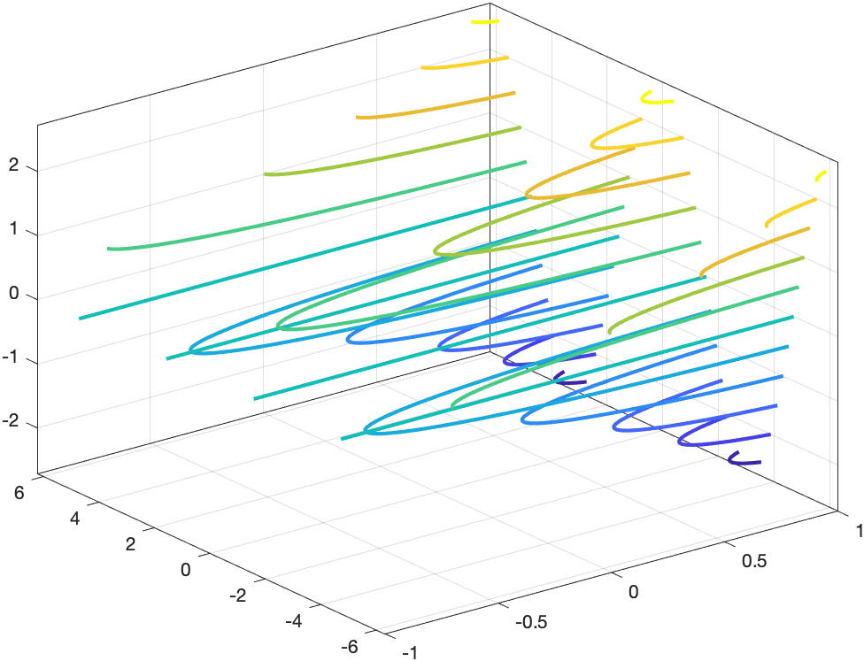
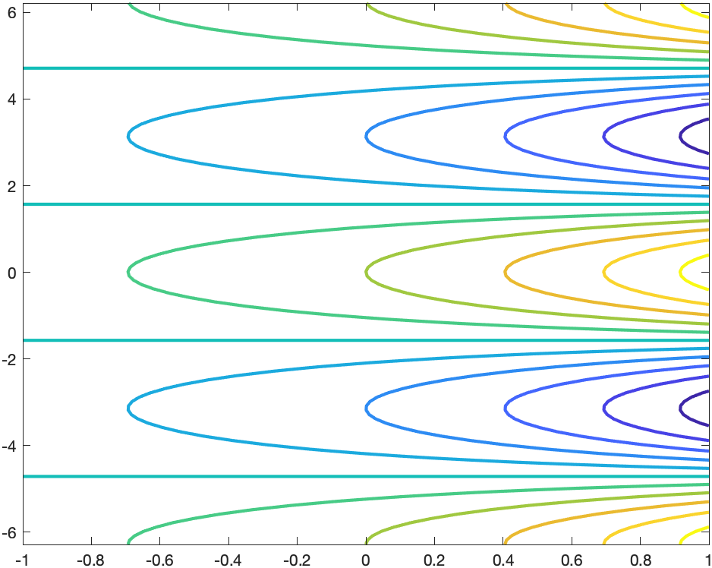
Command Window
>> contour3(x,y,real(z),’Linewidth',2);
>> contour(x,y,real(z),’Linewidth',2);

Slide 35
Thank You

